Slide 1

Eelo University Faculty of Computer Science and Business Technologies Course: Web Designing
Instructor: Abdurrahman Ahmed
Web Administrator, EU

Slide 2
Chapter Three
Lists, Links and Multimedia

Slide 3
Organizing Information
Lists are powerful tools to group similar elements, and lists give visitors to your site an easy way to zoom in on groups of information. Just about anything fits in a list, from sets of instructions to collections of links.
There are two types of lists:
✓ Numbered lists (Ordered List)
✓ Bulleted lists (Unordered List)

Slide 4
Numbered lists
A numbered list consists of at least two items, each prefaced by a number.
Use a numbered list when the order or priority of items is important.
You use two kinds of elements for a numbered list:
✓ The ordered list element (<ol>) specifies a numbered list.
✓ List item elements (<li>) mark each item in the list.
✓ The closing tag for the ordered list element (</ol>) indicates that the list has come to its end.

Slide 5
Bulleted lists
A bulleted list contains one or more items each prefaced by a bullet (often a big dot; this book uses check marks as bullets). Use this kind of list if the items’ order isn’t necessary for understanding the information it presents.
A bulleted list requires the following:
✓ The unordered list element (<ul>) specifies a bulleted list.
✓ A list item element (<li>) marks each item in the list.
✓ The closing tag for the unordered list element (</ul>) indicates that the list has come to its end.

Slide 6
Nesting lists
You can create subcategories by nesting lists within lists. Some common uses
for nested lists include the following
✓ Site maps and other navigation tools
✓ Tables of content for online books and papers
✓ Outlines

Slide 7
HTML LINKS
Hyperlinks, or simply links, connect HTML pages and other resources on the web. When you include a link on your page, you enable visitors to travel from your page to another website, another page on your site, or even another location on the same page.
Without links, a page stands alone, disconnected from the rest of the web.

Slide 8
Basic Links
To create a link, you need
✓ A web address (called a Uniform Resource Locator; URL) for the website or file that’s your link target. This usually starts with http://.
✓ Some text in your web page to label or describe the link. Make sure that the text you use says something useful about the resource being linked.
✓ An anchor element (<a>) with an href attribute to bring it all together. The element to create links is called an anchor element because you use it to anchor a URL to some text on your page.

Slide 9
Specifying locations in web pages
Locations within web pages can be marked for direct access by links on
✓ The same page.
✓ The same website.
✓ Other websites

Slide 10
Linking within the same page
Links can help users navigate a single web page. Intradocument hyperlinks include such familiar features as
✓ Back to Top links.
✓ Tables of contents.
An intradocument hyperlink, also known as a named document link, uses a URL like this:
<a href=”#top”>Back to top</a>
The pound sign (#) indicates that you’re pointing to a spot on the same page, not on another page.

Slide 11
Linking to non-HTML resources
Links can connect to virtually any kind of file, such as the following:
Word processing documents
✓ Spreadsheets
✓ PDFs
✓ Compressed files
✓ Multimedia

Slide 12
File downloads
For instance, if you want your users to download a PDF file named doc.pdf and a Zip archive called software.zip from a web page, you use this HTML:
<h1>Download the new version of our software</h1>
<p><a href=”software.zip”>Software</a></p>
<p><a href=”doc.pdf”>Documentation</a></p>

Slide 13
HTML MULTIMEDIA

Slide 14
HTML Multimedia
Multimedia on the web, is sound, music, images, videos, movies, and animations.
Multimedia comes in many different formats. It can be almost anything you can hear or see.
Examples: Pictures, music, sound, videos, records, films, animations, and more

Slide 15
Multimedia Formats
Multimedia elements (like sounds or videos) are stored in media files.
Multimedia files also have their own formats and different extensions like: .swf, .wav, .mp3, .mp4, .mpg, .wmv, and .avi.

Slide 16
HTML5 Video
Before HTML5, there was no standard for showing videos on a web page, videos could only be played with a plug-in (like flash).
The HTML5 element specifies a standard way to embed a video in a web page.

Slide 17
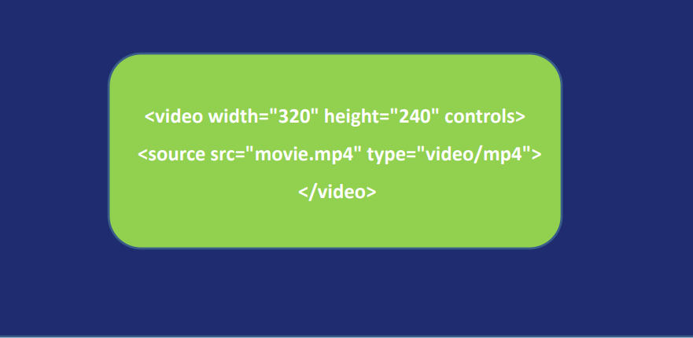
The HTML <video> Element
To show a video in HTML, use the <video>element:

Slide 18
How it Works
The controls attribute adds video controls, like play, pause, and volume.
It is a good idea to always include width and height attributes.
The browser will use the first recognized format

Slide 19
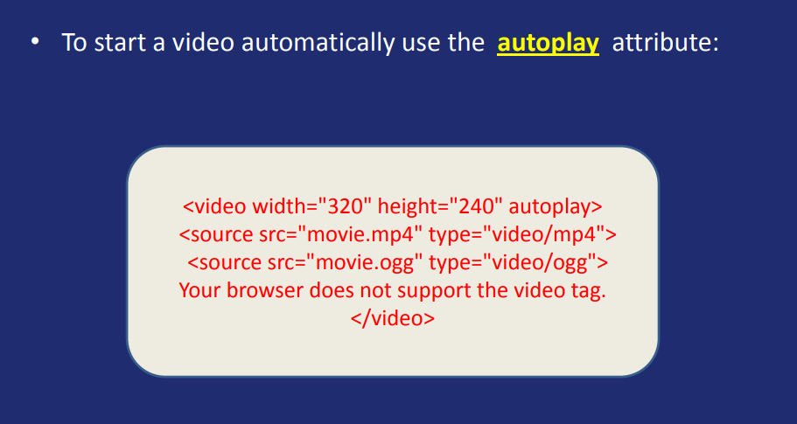
HTML Autoplay

Slide 20
HTML5 Audio
HTML5 provides a standard for playing audio files
Before HTML5, there was no standard for playing audio files on a web page.
Before HTML5, audio files could only be played with a plug-in (like flash).
The HTML5 element specifies a standard way to embed audio in a web page.

Slide 21
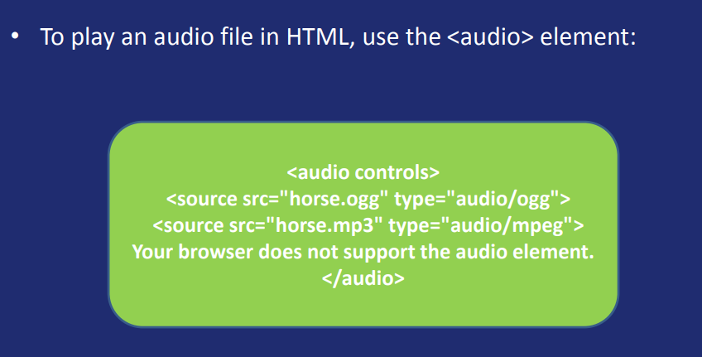
The HTML Element

Slide 22
HTML Audio - How It Works
The controls attribute adds audio controls, like play, pause, and volume.
Multiple elements can link to different audio files.
The browser will use the first recognized format.

Slide 23
HTML Plug-ins
The purpose of a plug-in, is to extend the functionality of the HTML browser.
Helper applications are also called plug-ins.
Plug-ins can be added to web pages with the <object> tag or the <embed> tag.

Slide 24
THE <embed> Element
The <embed> element is supported in all major browsers.
The <embed> element also defines an embedded object within an HTML document.
Web browsers have supported the <embed> element for a long time. However, it has not been a part of the HTML specification before HTML5.

Slide 25
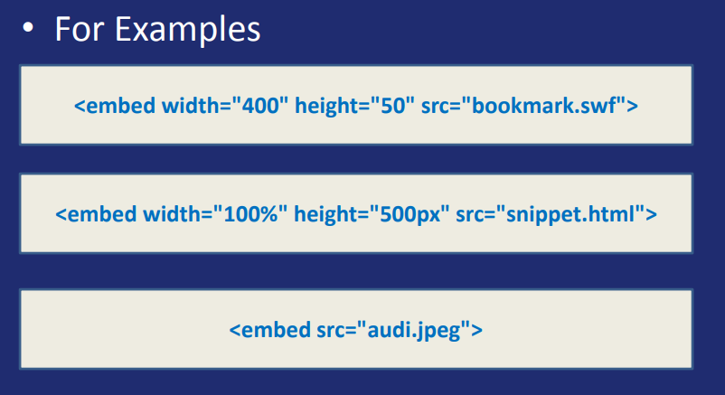
The <embed> element

Slide 26
HTML youtube videos
The easiest way to play videos in HTML, is to use YouTube.
Different versions of different browsers support different video formats.
Converting videos to different format can be difficult and time consuming.
Easier solution might be to let YouTube play the videos in your web page.

Slide 27
HTML Image Syntax
In HTML images are defines with <img> element
The <img> is an empty element
Example
<img src="img_eelo.jpg" alt=“Eelo University">
The <src> attribute specifies the url or the location of the image
The <alt> attribute provides an alternate text of the image

Slide 28
Image Size
The width and height attributes of the IMG element specifies the width and height of an image.
<img src="example.gif" alt="Example" width="200" height="100">

Slide 29

END OF CHAPTER 3

